Slide 1

SQL IPL 2024 Analysis Project
🏏 Welcome to IPL 2024 SQL Analytics Showdown!
Powered by Data | Driven by Stats | Presented by Sanyam Pareek
🔥 Get ready for a thrilling match between SQL Queries and IPL Insights!

Slide 2
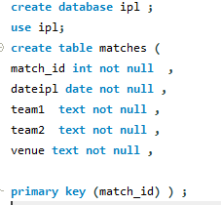
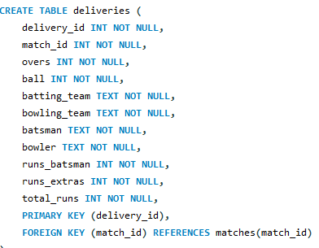
Database Schema

Slide 3

SQL Query & Results

Slide 4

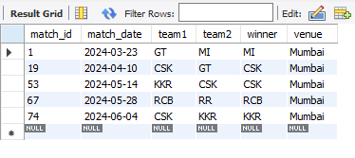
Question_1. list all matched played at the venue = “Mumbai”.

Slide 5
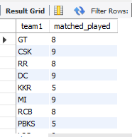
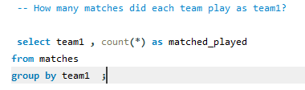
How m
Question 2
How many matches did each team play as team1 ?

Slide 6
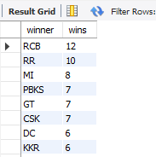
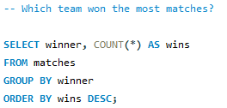
Question 3
Which team won the most matches ?

Slide 7
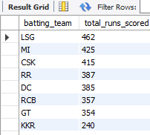
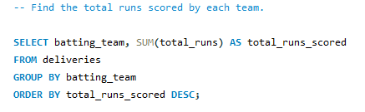
Question 4
Find the total runs scored by each team ?

Slide 8
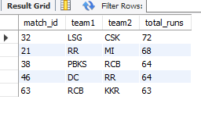
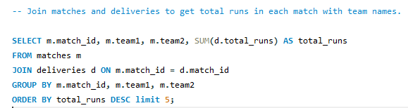
Question 5
join matches and deliveries to get total runs in each match with team names

Slide 9
✔ What I Achieved:
Built a structured IPL database with 2 relational tables: matches and deliveries
Wrote advanced SQL queries using GROUP BY, JOIN, WHERE, and aggregation functions
Demonstrated an end-to-end sports analytics workflow using real IPL 2024 data
✔Business Impact / Insights:
Identified top batsmen by total runs and sixes (e.g., Player X with 30 sixes)
Analyzed team performance across venues using pivot tables (e.g., MI won 5 times in Mumbai)
Discovered match trends like highest scoring matches and venue-based performance

